Slide 1
Summary of Human Systems Integration Body of Knowledge and Competency Assessment Workshop Held at NPS November 13 – 14, 2019
COL (ret) Larry Shattuck, Ph.D.
6 December 2019

Slide 2
Purpose
Brief Statement of Work:
This proposed research supports ongoing activities of the DOD Joint Human Systems Integration Working Group (JHSIWG) and has two objectives.
First, we will bring together knowledgeable and experienced HSI practitioners from across the DOD and other Federal agencies to develop an HSI Body of Knowledge (BOK).
Second, we will develop an HSI Competency Assessment process that can provide feedback to both the HSI workforce to assess individual strengths and weaknesses and to organizational leadership to determine when and how to invest in HSI workforce training and education.
DAWDF Funded Project
Facilitated through OUSD R&E AC/EPS (Mr. Andy Monje)
Acknowledgements: Mr. Mitch Woods, Mr. Jeff Thomas, NPS HSI Faculty, NPS OR Dept Staff, NPS Administrative Staff, MHSI Students, Topic Mentors and SMEs

Slide 3
Agenda: Day 1
Gap Overview (Rick Etheridge and Gap Leads)
Gap 1/Topics 1&3: “Factors for Creating a Useful and Enduring HSI Body of Knowledge” (LCDR Aron Rotklein & LT Christine Tyndall)
Gap 2/Topic 4: “Establishing a Common DOD HSI Lexicon” (Ms. Katie Ricker)
Gap 2/Topic 5: “Anthropometry Data Item Description” (LT Travis Lee)
DOE HRL Workshop Backbrief (CDR (ret) Mike O’Neil)
Gap 3/Topic 6: “HSI Competency Model and Course Alignment” (LtCol Jon Schaafsma)
Gap 3/Topic 7: “DAU CLE062 HSI Module Update” (LT Matt Nicholson)
Gap 4/Topic 9: “Capability Gap of a Standardized HSI Tool Repository” (LT Austin Lugo)

Slide 4
Agenda: Day 2
Gap 3/Topic 10: “HSI Certification Analysis and Recommendations” (LCDR Granny Wright)
HSI Competency Assessment Discussions (All)
Gap 1/Topic 2: “Mapping of HSI Resources and Activities” (LCDR Vince Deguzman)
Gap 3/Topic 8: “Competency Model for the Department of Defense” (Mr. Dynnis Feliciano)

Slide 5
Attendees
Janae Lockett-Reynolds (DHS)
Austin Lugo (MHSI)*
Steve Merriman (Boeing)
Mike Miller (USAF)*
Matthew Nicholson (MHSI)*
Mike O’Neil (NPS)
Joe Parham (Army)
Jim Pharmer (Navy)
Aditya Prasad (Navy)
Katie Ricker (MHSI)*
Aron Rotklein (MHSI)*
Dale Russell (Navy)
Mark Rutherford (USCG)
Jon Schaafsma (MHSI)*
Larry Shattuck (NPS)
Nita Shattuck (NPS)
Chris Taylor (USAF)
Jeff Thomas (Army)
Christine Tyndall (MHSI)*
Alonso Vera (NASA)
Mitch Woods DOD)
Granville Wright (MHSI)
*Indicates did not attend in person
Liana Algarín (DOD)
Chris Barrett (DAU)
Adam Burkley (NPS)
Bud Couch (Navy)
Brennan Cox (NPS)
Barbara deBary-Kesner (Navy)
Vince Deguzman (MHSI)*
Rick Etheridge (Navy)
Dynnis Feliciano (MHSI)*
Fran Greene (NPS)
Rachel Heffner (USAF)
Travis Lee (MHSI)*

Slide 6
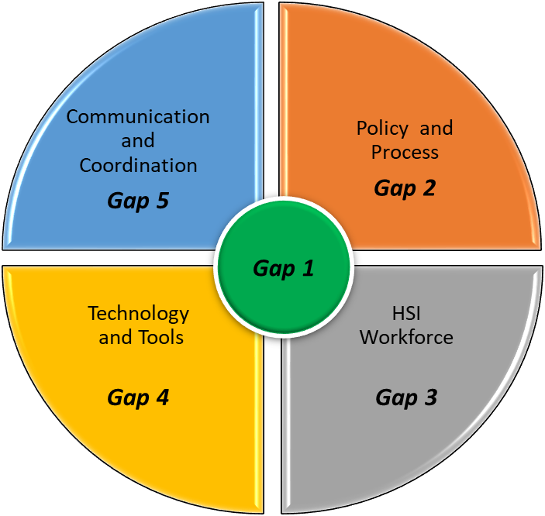
Reminder: HSI Gaps
As Is
To Be
Gap 1: Institutionalize an HSI Body of Knowledge
Gap 2: Standardize HSI Best Practices across the Services
Gap 3: Develop Career Certification and Career Paths/Billets for HSI Workforce Supported by a Persistent Training Function
Gap 4: Provide and Maintain Tools, Databases, and Processes to Support HSI Analyses Early in Acquisition
Gap 5: Implement a Professional, Coordinated HSI Outreach and Marketing Function

Slide 7
Factors for Creating a Useful and Enduring HSI Body of Knowledge
Aron Rotklein / Christine Tyndall
Michael O’Neil, M.S., CHFP (Advisor)
OA4415/ Summer
13 November 2019

Slide 8
What if?
… practitioners could upload and share documents in total transparency with the ability to rate utility?
…practitioners could poll an ‘ask the expert’ forum and receive feedback from across the HSI community of practice, and have these answers preserved for future use?
…there was an HSI new idea forum where practitioners could vote and comment on new ideas?
… the HFE TAG presented an annual award for the best contribution to the HSI Body of Knowledge (BOK)?

Slide 9
Purpose
Examine existing Knowledge Management (KM) processes and bodies of knowledge within the HSI community
Evaluate their effectiveness against established KM heuristics and ‘failure factors’
Identify candidate KM approaches to meet the needs of the HSI community
Notes:
-The purpose of this study is to examine existing KM processes and bodies of knowledge within the HSI community and evaluate their effectiveness against published scientific requirements and KM failure factors. More specifically, we will answer the questions: Are there any existing processes or bodies of knowledge? If so do they account for all the elements laid out in existing KM frameworks? Do the exhibit factors that are impediments to KM? Do they exhibit factors that benefit KM?
-The identification of capability gaps will result in the analysis of alternative KM options to meet the needs of the community. Specifically the questions we just asked should provide us with capability gaps and needs requirements to conduct an analysis of alternatives and provide a recommendation for a useful and enduring body of knowledge.

Slide 10
Capstone Activities
KM Literature Review
KM Model
Failure/Success Factors
Practitioner Interviews
Interview Themes
Prelim Needs / Requirements
Prelim Alternatives Analysis
Recommendation
Notes:
Our project consisted of several key activities that enabled us to root our conclusions and recommendations in a quantitative and qualitative methodological approach to content analysis of existing Knowledge Management processes both within the HSI community specifically and within the broader range of Knowledge Management (KM) frameworks as a whole. Our project began with a literature review, which encompassed the theory behind KM, existing frameworks, analyses of both failed and successful KM projects, and studies on how success factors can be optimized within the context of KM. More specifically, articles were searched for the definitions and existing frameworks of KM, in order to scope the required general purposes and functions of KM. Following this determination, research of literature was conducted to examine the common causes behind the failures of historical KM ventures. These failure items were then explored through a more extensive literature review to encompass root causes and potential solutions.
Following the literature review, a phone survey was conducted among four HSI professionals. The survey took place in August 2019, and will be discussed in greater detail in following slides. The themes of the surveys were compiled and represent the basis of the needs-analysis for the proposed body of knowledge.
Upon completion of the interviews, results were compiled and requirements were developed.
In the next step, research was conducted to examine the possible alternative solutions to create and host an HSI body of knowledge. This consisted of reviewing existing commercial off the shelf (COTS) systems, government off the shelf (GOTS) systems, and the possible development of a new system. This research consisted of an initial review of COTS and GOTS cost and specifications in program websites. The reviewed COTS systems consisted of Zendesk, Bloomfire, Centralpoint, Knowledge Center, Happy Fox, Zoho Desk, and SABIO Knowledge Management. Finally an analysis of alternatives was conducted

Slide 11
Preliminary AoA
dd
Option | Cost | Simplicity | Ease of Use | Reward System | Metrics for ROI | Data Org Features | Quality Control Features | Annual Man-hour Estimate
Commercial Database | High | Excellent | Excellent | Medium | Excellent | Excellent | Excellent | Low
Web Based Forum | Low (free) | Excellent | Excellent | Medium | Low | Medium | Low | High
Web Based Blog | Low (free) | Excellent | Excellent | Medium | Low | Medium | Low | High
DAU Based Website | Low (free) | Excellent | Excellent | Medium | Medium | Medium | Medium | High
(Ratings provided by capstone team)
Notes:
As the insufficient resourcing is a primary indicator of KM failure, the cost of the system is a significant consideration in the trade space for selection. Management support, responsibility, accountability, and ownership are required for KM success. The body of knowledge management team should include HSI professionals. Additionally, the system and organization should be aligned with HSI goals and include a mechanism to measure KM success. As a result, the trade space must include manpower and organization structural concerns. The system, itself, must be simple and easy to use. Additionally, content management is essential for the body of knowledge to be useful and sustaining. This means that the search function must return applicable results, the database must contain enough storage space and bandwidth to house all relevant information, accommodate 50% of HSI users, and operate at a fast enough speed not deter use. The content should be organized by topic, phase of acquisition lifecycle, or other appropriate tag. Users must be motivated to contribute to the database, and thus the system should incorporate intrinsic or extrinsic motivational factors. Because the body of knowledge deals with the DoD acquisition lifecycle, it may be useful to include encryption in the consideration of alternatives.
Cost
For the purposes of this paper the scope of the cost of the system will consider the direct costs across the lifecycle of the system. A COTS system would require an annual fee. This fee varies based on the selection of the provider as well as the features provided in the service. With a program such as the one offered by Bloomfire, assuming greater than 50 users would be operating the system, this fee would be $13,788 annually. As offered by Zendesk, the price could range between $5-199 per agent per month. For a package that would satisfy the requirements of an HSI body of knowledge, $199 per agent per month would likely be the appropriate option. While determining the number of agents required is a topic for further research should this option be selected, the annual cost could range from $2,388 to $11,940 for 1 to 5 agents. It should be noted that these costs are for FY19 and not projected for future dates. As such cost increases may occur. Additionally, the developers and operators of the website have no knowledge of HSI, and the systems tend to be developed commercially for businesses to interact with their customers. As a result, an HSI practitioner needs to be involved in the development, operation, and content management of the system in order to ensure that useful content is displayed appropriately. While, due to the artificial intelligence (AI) capabilities and agent positions provided by the knowledge management companies, this role would not necessarily have to be the primary role of the HSI practitioner, it would require the content manager be responsible for the program and to have a relatively holistic view of HSI as a discipline. As a result, it should be assumed that the role would be filled by a GS-13, with an annual salary of $73,115.00 - $95,048.00. If it were a primary duty, the salary may be less. This is a topic for follow-on research, should this option be selected. Other cost factors to consider with the commercial option is that system maintenance and updates would be included in the annual cost.
By utilizing a Defense Acquisition University (DAU) system, there would be no annual fee associated with the system’s use. It would require information technology (IT) personnel and HSI practitioner collaboration during the development of the website, the expense of which would depend on the development schedule. Following the initial cost and involvement of these personnel, the website would offer several of the same AI capabilities as the commercial alternatives, reducing manpower in comparison to a forum or blog option. However, content management and IT support would persist throughout the system’s lifecycle. In this case, a HSI practitioner employed as a content manager and an IT specialist to provide support would be required. While the IT specialist would have other responsibilities, the salaries of which would combine to between $100,000 to $150,000 annually.
By utilizing either a web-based forum or blog, there would be no annual fee associated with the system’s use. Much like the DAU option, the development of the system would require collaboration between IT and HSI personnel, with a schedule to be determined. These options would require extensive content management, with one or more HSI practitioners filling this role as a primary duty. As such, the annual salary cost would be over $60,000 annually.
Organization and Roles
The COTS alternative requires the least organizational involvement of the four options. In general, the site would be entirely maintained by the contracted company. The disadvantage, organizationally, with choosing a COTS option is that the companies tend to have little to no experience with HSI or with operating with government agencies. As a result, HSI practitioner oversight would have to occur in order to manage and validate content in order to ensure the body of knowledge is useful and appropriate.
The DAU alternative would be similar to that of a COTS system, with the exception that slightly more involvement would be required. This is due to the fact that, while not perfect, the COTS alternative includes the assignment of agents to the database that can provide IT support and content management. The DAU alternative would require support to fill in those gaps.
A forum or blog option would require one or more content managers or gatekeepers. This is because these options do not have AI capabilities that would organize, tag, or provide version control on content. Useful information would not automatically be returned from a search function. Additionally, without content managers or gatekeepers, the content could not be verified for accuracy. Of great concern with this option is that the content managers or gatekeepers would be so intrinsically essential to the system that the turnover or poor performance of said personnel may contribute to the disarray or collapse of the usefulness of the system.
With any alternative, it is imperative that the organization foster a culture of contribution, collaboration, and participation. As no process is currently in place to ensure that contributions occur, leadership must encourage the use of the body of knowledge. When an employee produces a quality product that others can learn from, lessons learned or after action reports are made, or other pertinent work is completed, it should become part of the workflow that employees input the information to the system.
Performance
A COTS alternative offers several performance advantages. It enables access to the system through internet, cloud, mobile app, and installed services, making it easy to access. The systems provide Return on Investment (ROI) metrics, such that the organization can measure participation, knowledge transfer, and improvements in efficiency. The systems are readily designed to organization requirements. This makes them simple, easy to use, and limits the keystrokes necessary to accomplish tasks. Motivational elements such as gamification and rating systems can easily be incorporated into the design. COTS systems offer large amounts of data storage and unlimited bandwidth. Data storage is an essential feature, because it allows the body of knowledge to grow. Bandwidth enables ease of use. Finally encrypted services can be utilized as need be. The COTS system would have AI features, which would support content management and version control. The COTS system could incorporate blog, forum, ask the expert, and FAQ functions.
A DAU alternative offers many of the same advantages as the COTS option. While it is only accessed through the internet, as opposed to the extensive options available with COTS, the website would be relatively easy to find when utilizing a search engine. The design would meet organization requirements pertaining to simplicity, ease of use, and limited keystrokes. DAU offers unlimited data storage and bandwidth, ensuring that 50% of HSI users can utilize the site. Much like COTS, AI features and encryption, gamification, blog, forum, ask the expert, and FAQ functions are available. DAU would not be able to provide the same advanced metrics and ROI functions that COTS systems offer.
A third alternative would be to create a forum with the ability to ask and answer questions, post HSI lessons learned, and post official DoD HSI references. This forum could have a search function to easily search for information that relates to a specific aspect of HSI and/or the DoD acquisition process. Free options exist to create a forum, with an example being www.Wix.com. This site, among others, would allow for the user to create a user-friendly, customizable, and professional looking website with a variety of templates to choose from. While the website, itself, would be free, it comes with severe performance limitations. The free options have limited storage capabilities, often less than 3 GB. Additionally the bandwidth is generally less than 2 GB. While these sizes should not necessarily prove to be problematic, particularly at first, as the site grows, it may require more storage and bandwidth to accommodate 50% of HSI users. Free options can only be located on the internet, and it could not be guaranteed that the site would be easy to find if utilizing a browser search function. The forum would have no ability to manage content with AI, and, as a result, in order to stay relevant, this forum would necessarily require a gatekeeper and moderators to supervise version control and relevance of content. Without this intrusive management, the website would not be useful and enduring. Additionally, the site would not be able to offer the same metrics or rewards that a COTS or DAU system could provide.
A final alternative would be to create a web-based blog. This would have much of the same advantages and disadvantages as the web-based forum. Blogs are generally more personal and deal with the point of view of a single person, small group, or an organization. A forum is designed for many people (a community) to share knowledge, lessons learned, ask and answer questions, and post examples of procedures and processes that have been designed to standardize work-flow within the industry. Because blogs are more personal than either websites or forums, they provide intrinsic motivational elements wherein the individual contributor achieves a sense of pride by gaining name recognition and accolades within the community.

Slide 12
Conclusions and Recommendations
Utilizing a DAU-based website space for an integrated HSI knowledge management appears to satisfice most/many KM requirements based on initial evaluation.
Potential Path Forward for HSIWG:
1. Incorporate KM approach; BOK -> BOKM
2. Develop detailed requirements for the HSI BOKM, including user roles, desired functions, basic workflow requirements, staffing estimates
3. Develop a Beta BOKM site, test, improve and scale
Notes:
DAU option is most closely aligned to HSI and the acquisition lifecycle.
DAU already contains a body of knowledge pertaining to the acquisition lifecycle. Using the DAU option will enable the sit to be closer to a “one-stop-shop” for the acquisitions community that HSI is so intertwined within.
The DAU option is the second most cost effective option (not much more cost than the COTS alternative). This cost difference is based primarily on the fact that the COTS provider would not be providing the same level of KM and HSI expertise amongst its employees tasked with interacting with HSI practitioners. This could result in ineffective communication and/or delayed adoption of the body of knowledge.
Additionally, HSI professionals are already familiar with the DAU site which means accessing the site will not be a new process. This removes an important barrier to transition and adoption.

Slide 13
Establishing a Common DoD HSI Lexicon
LCDR Brennan D. Cox, PhD, MSC, USN
on behalf of Ms. Katie Ricker
OA4415/Summer 2019
13 November 2019

Slide 14
Capstone Objectives
A common lexicon is required to communicate the purpose, intentions, and value of HSI.
Review HSI resources
Survey stakeholders
Make recommendations

Slide 15
Watch your Language!
We lack consensus in how we communicate within the HSI universe.
Domains
Definitions
Policy
Guidance
Standards
Training
Management
Execution
DoD |  | US Army | USAF | USN/USMC | USCG
DoDI 5000.02 | MIL-STD-46855A | AR 602-2 | AFI 63-101/ 20-101 | SECNAV 5000.2E | COMDTINST M5000.10D
HFE | Human Engineering | HFE | HFE | HFE | HFE
Manpower | Manpower | Manpower | Manpower | MPT | Manpower
Personnel | Personnel | Personnel | Personnel |  | Personnel
Training | Training | Training | Training |  | Perf. Support & Training
Force Prot. & Survivability | Personnel Survivability | Soldier Survivability | Survivability | Personnel Survivability | Survivability
Safety & Occ. Health | Health Hazards | Health Hazards | Occupational Health | ESOH | System Safety & Occ. Health
 | System Safety | System Safety | Safety
Habitability | Habitability |  | Habitability | Habitability | Habitability

Slide 16
The Walk and Talk Matrix
Involved in HSI work, but uses HSI language in an inconsistent or incorrect manner.
Low Fluency
High Application
High Fluency
High Application
Ideally, members of the HSI community communicate with a common language and apply it regularly.
High
HSI Application
Low Fluency
Low Application
High Fluency
Low Application
Able to describe the principles and practices of HSI, but does not apply this knowledge.
Lack of understanding and applied use of HSI principles and practices.
Low
Low
High
HSI Fluency

Slide 17
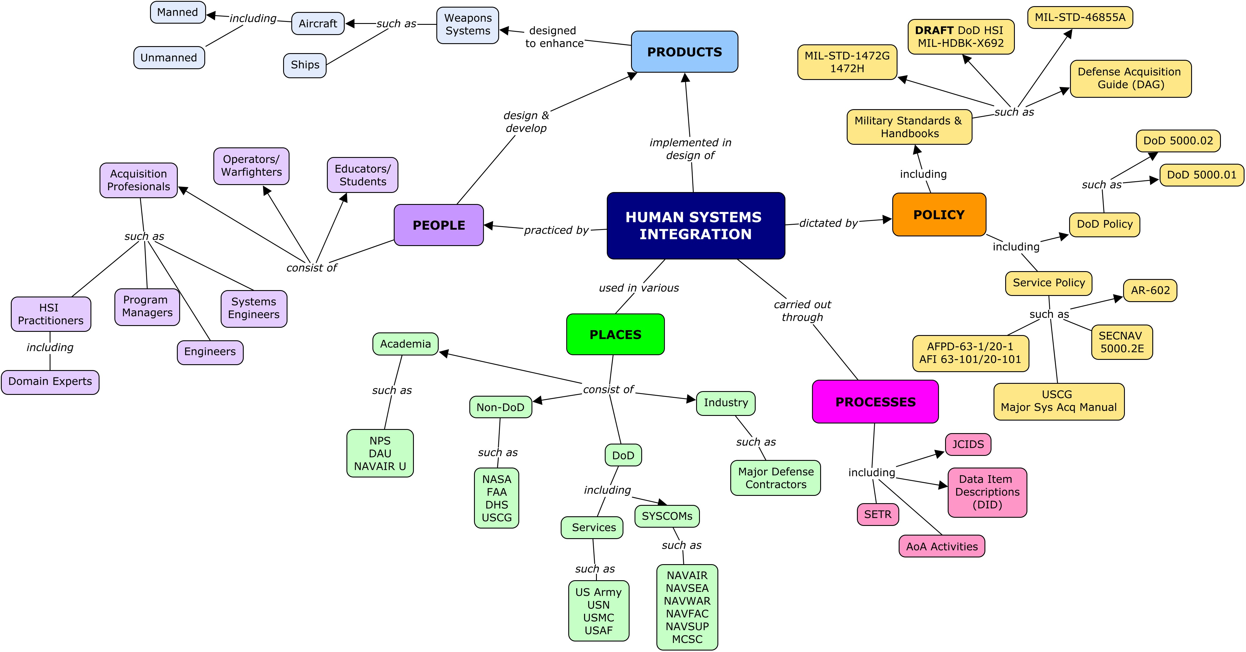
The HSI Universe

Slide 18
Recommendations
Scope the effort
Invite involvement
Promote change
Implement updates
Maintain lexicon

Slide 19
HSI Gap 2: Anthropometry Data Item Description
LT Travis “Earl” Lee (NAS Patuxent River)
OA4415 / Summer AY2019
13 November, 2019

Slide 20
Literature Review
Objective
Establish a baseline of policy, standards, and approved DIDs
MIL-STD-1472G
MIL-STD-963C
HEDAD-O
HEDAD-M
Findings

Slide 21
Methodology
Began with existing draft
Based heavily on a draft Soldier Workspace Analysis DID
Challenge of “helmet to warship”
Consult with the experts
Ms. Barbara deBary-Kesner
Focus: Document the methodology and the output
Mr. Joe Parham
Scope: Consider how the DID will be used to drive the language
Mr. Steve Merriman
Execution: Leveraging his experience to refine the DID

Slide 22
Results
Avoiding over-constraint
Clean formatting
Defined users
Anthropometric Accommodation Analysis Report format
Decided by the contractor
Content requirements provide flexibility
Some overlap with HEDAD-O & HEDAD-M
Focus on the accommodation
Implications of results

Slide 23

Draft Anthropometry DID

Slide 24
HRL Working Group Update
Mike O’Neil, M.S., CHFP
13 November

Slide 25

Current Effort
Sponsor: DOE/Sandia NL
Objective: The primary purpose of the HRL scale is to serve as a tool to communicate the readiness of a system for human use to high-level decision makers such as program managers and the acquisition community.
Timeframe: Initial one-year charter from August 2019 through August 2020, with possible follow-on year(s)

Slide 26
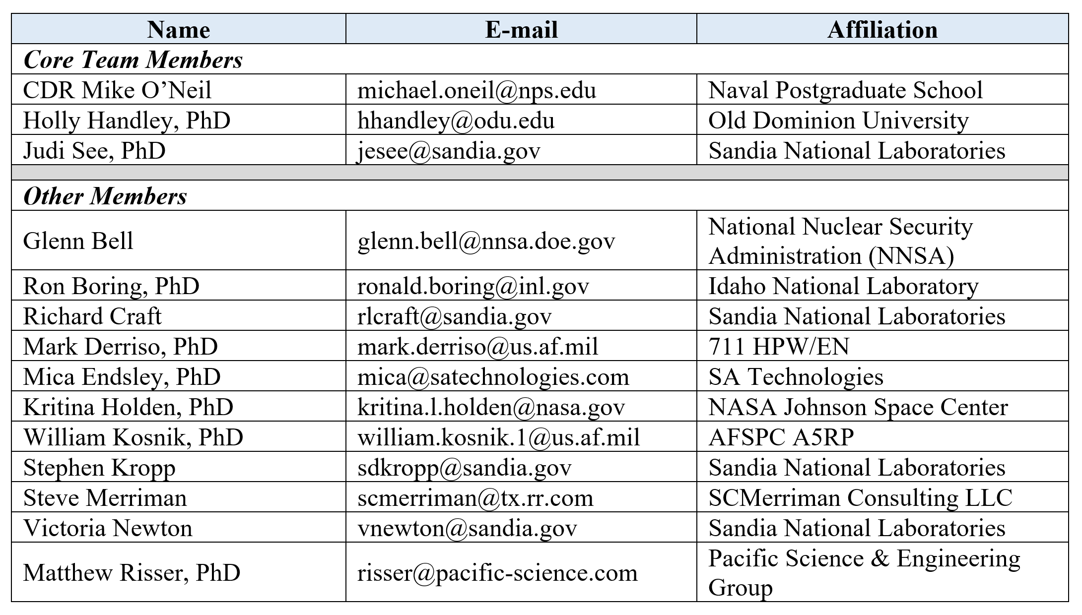
Team

Slide 27
Key Issues
Naming Convention
Performance versus Process
Criteria for ‘Yes’
Measurement Approach

Slide 28
Opportunities
Effort to develop an HSI metric with broad applicability
Natural opportunity for DoD/DOE partnership/collaboration
Opportunity to crowd-source development via APAN
Next HRL Workshop in Spring – ODU:
Tabletop Exercises
Scale Refinement

Slide 29
Human Systems Integration Competency Model and Coursework Alignment
Jonathan Schaafsma
MHSI Capstone
13 Nov 2019

Slide 30
Background
Tying courseware to a community accepted competency model will allow for the identification of:
Knowledge, skills, abilities, and other attributes (KSAO) currently included in coursework
Gaps in current coursework with respect to necessary competencies
Which competency model is the best?
How detailed?
Levels of performance (e.g., Level I, II, and III; entry, intermediate, advanced, expert)
Exit criteria

Slide 31
Coursework Review
Over 100 HSI and HSI-related courses across the institutions
Naval Postgraduate School
16 total courses for Master of Human Systems Integration
4 courses for Certificate in Human Systems Integration
Air Force Institute of Technology
SYS-169 Introduction to Human Systems Integration
SYS-269 Human Systems Integration in Acquisition
Certificate program pending
Defense Acquisition University
Multiple HSI-related courses
CLE-062 Human Systems Integration
Not included
Virginia Tech (certificate program)
Georgia Tech (HSI courses related to DoD acquisition)
FAA
NASA
Others?
Notes:
Some examples of HSI-related courses:
DAU CLE-030 ESOH in JCIDS
AFIT HFEN-670 Human Interaction Technologies
AFIT HFEN-560 Introduction to Human Factors
AFIT HFEN-610 Human Performance Measurement
AFIT HFEN-620 Human Performance Modeling
DAU TST-102 Fundamentals of Test and Evaluation
GTRI DEF-4504P Introduction to Human Systems Integration
GTRI DEF-4527P Human Systems Integration Test and Evaluation Methods
AFIT Certificate program is expected to begin Winter Quarter 2020 and will include:
HFEN-565 HSI Domains (new)
HFEN-668 HSI Trade Space (new)
HFEN-560 Human Factors Engineering
Either HFEN-620 (Human Performance Modeling), HFEN-663 (Software User Interface Design), or HFEN-665 (Human-Agent Interaction)
AFIT’s current goal is six HSI students per cohort. As of September 2019, there were three students enrolled. Typically, students who participate in HSI courses are focused on human factors in aeronautics and computer science.
Virginia Tech does not currently have any HSI students enrolled in their program.

Slide 32
Sample Competency Model
This sample from the competency model developed during the research of this topic ties courseware from NPS, AFIT, and DAU to “Level I” performance. It is a variation of the DHS model but altered to align with the defense acquisition lifecycle. The specific HSI competencies are examples of those that could fall within the Technology Maturation and Risk Reduction phase of the defense acquisition lifecycle.

Slide 33
Recommendations
Engage with personnel involved in Topic 8 to develop community accepted competency model
Include sufficient detail to determine contribution of individual courses across the institutions
Reference the Defense Acquisition Framework and the USAF HSI Framework to aid in identifying valid HSI competencies
Notes:
One of the other topics associated with Gap 3 as identified by the JHSIWG involves the review and analysis of competency models. Leverage this work to produce an HSI community accepted model that can be used for current and future coursework alignment.
Level of detail must be sufficient to identify the contributions of individual courses; however, oversight is advised to prevent the number of competencies from growing to an unmanageable number.
Defense Acquisition Framework: http://faculty.nps.edu/dl/HSI_Certificate_program/OA3412/AcquisitionLifecycleGraphic/da_framework.html
USAF HSI Framework: http://pseex.pacific-science.com/Hsif2/

Slide 34
DAU CLE062 HSI Module Update
Matthew C. Nicholson
OA4415/ Summer 2019
13 Nov 2019

Slide 35
Game Plan
L1 first
- Largest lesson plan
- Core content of entire module
L2 → L3 → L0 → L4
- Develop the bulk learning material
- Adjust L0 and L4 based on changes
Periodic collaborative reviews
- Review content, review graphics, consolidate

Slide 36
Tools & Resources
CRM: Comment Resolution Matrix
- Provide standard format
- Classification of comments
- Track suggested changes
- Rationale for recommended change
- Adjudication and rationale

Slide 37
Data
10 weeks
8 review meetings
5 updated modules
- 160 total changes
95 to L1 (60%)
40 new pictures/graphics

Slide 38
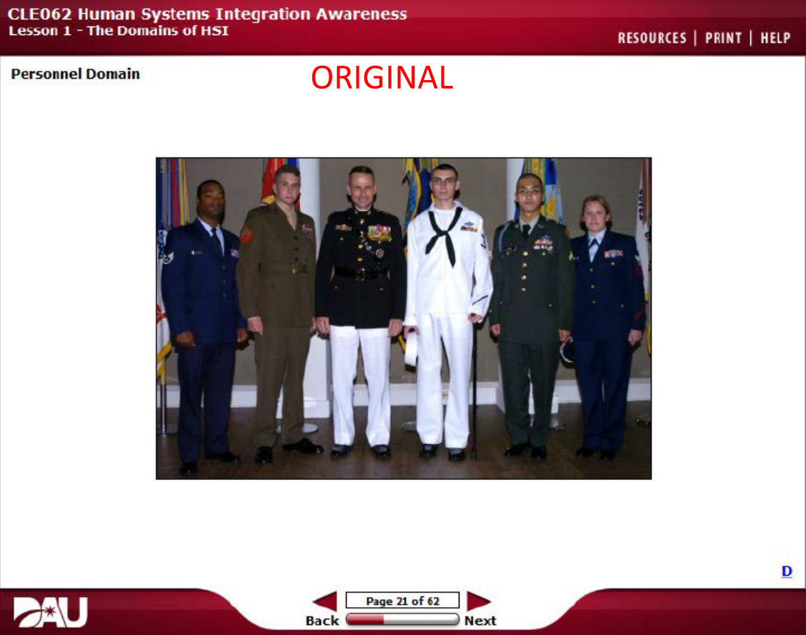
Showcase

Slide 39

Showcase

Slide 40
Challenges
Restrictions
- Content volume
- Content references
Distance
Input management
- Opinions
- CRMs
Visionary output/quality
PDF format

Slide 41
Capability Gap 4: A Standardized HSI Tool Repository
Austin Lugo
Nov 2019

Slide 42
Methodology
Compiled list of other repositories
Reviewed and eliminated duplications
Verified active status 229 --> 180
Allocated to domains and activities

Slide 43
Key word search
HSI Tools
HSI Tools List
HSI Tool Repository
HSI Tool Survey
HSI Tool Catalog
HSI Tool Database
(US Government) HSI Tools

Slide 44
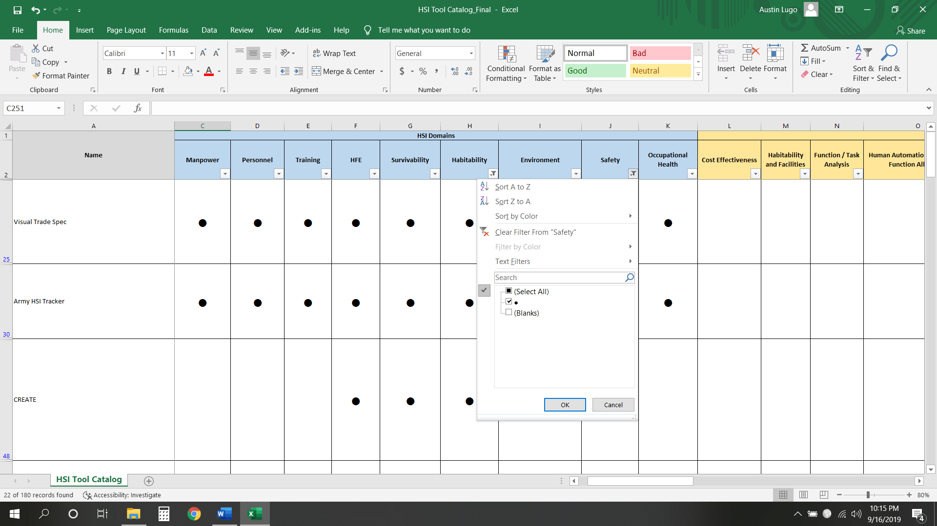
HSI Domain Filter

Slide 45
Next Steps
Continue to update Excel Spreadsheet with new TTAMs
Update Domains and Activities as appropriate

Slide 46
HSI Certifications Analysis and Recommendations Tool
CDR Granville “Granny” Wright
OA4415 / Summer AY19
November 14, 2019

Slide 47
Agenda
HSI Related Professional Certifications
HSI-CART
Application and Recommendations
Next Steps

Slide 48
PCAT
Compare different professional certifications using common characteristics (definition of each row)
Education
Experience
Testing
Other requirements (demos, work examples, interviews, etc.)
Maintaining certification
Hierarchical versus Horizontal certifications
List detailed characteristics for each certification (columns of data)

Slide 49
DCAT
Compare DAWIA career fields with focus on education and experience requirements
Compare 6 of 14 DAWIA career fields (columns)
Cost Estimation
Engineering
Facilities Engineering
Program Management
Science and Technology Manager
Test and Evaluation

Slide 50
Next Steps
Designating leadership
Essential advocacy
Selecting an approach
Informs approach to HSI Body of Knowledge development
Establishes method of maintaining certification
Resourcing considerations
Independent professional organization?
Existing professional organization?
DAWIA career field considerations?

Slide 51
Mapping of HSI Resources and Activities
Vince Deguzman
Nov 2019

Slide 52
Methodology
POAM
HSI toolkit
References
Activities
APAN
SharePoint

Slide 53
Screenshot of the HSI toolkit

Slide 54
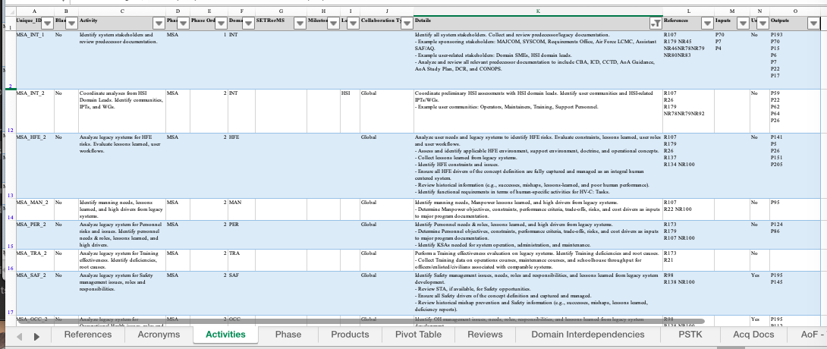
Screenshot of the Activities tab

Slide 55
Next Steps
Continue to update workbook with new references
Update other tabs in the workbook

Slide 56
HSI Competency Model for DoD
Dynnis Feliciano
OA4415/ Fall
Nov. 6, 2019

Slide 57
Agenda
Methods
Develop milestones and plan of action
Review existing competency model
Characteristics across HSI domains
Excel Spreadsheet
Access database
Results
Excel Spreadsheet
Access Database
Conclusion and Recommendation

Slide 58
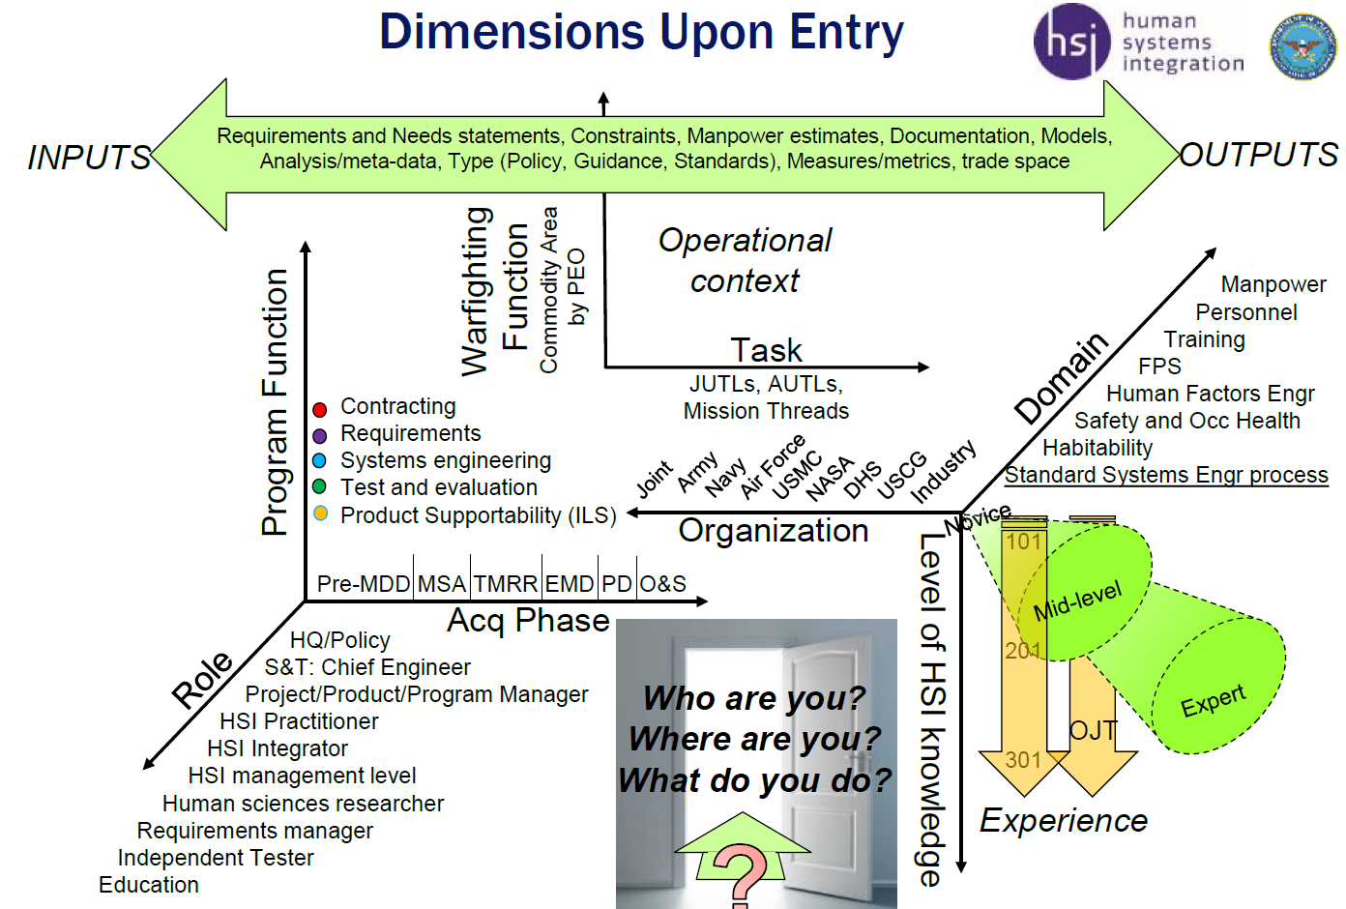
Dimensions relevant to HSI

Slide 59
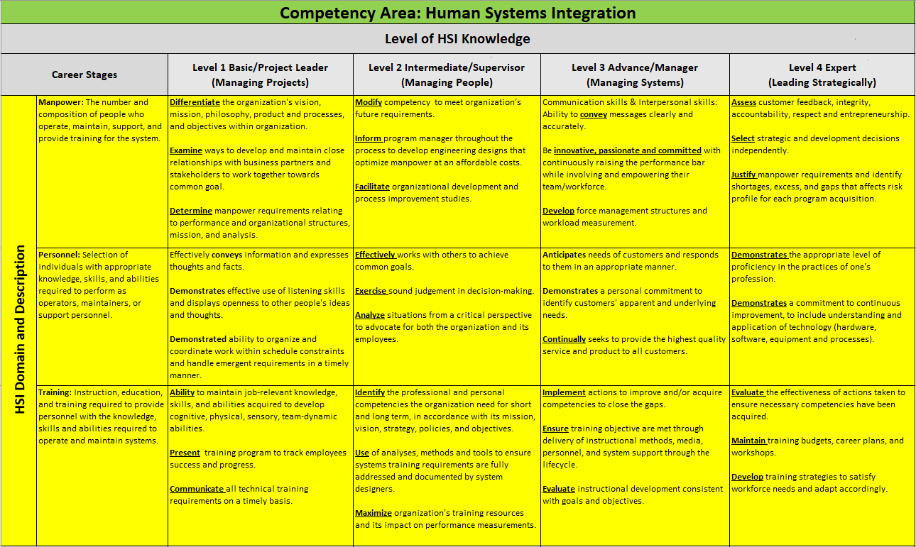

Slide 60
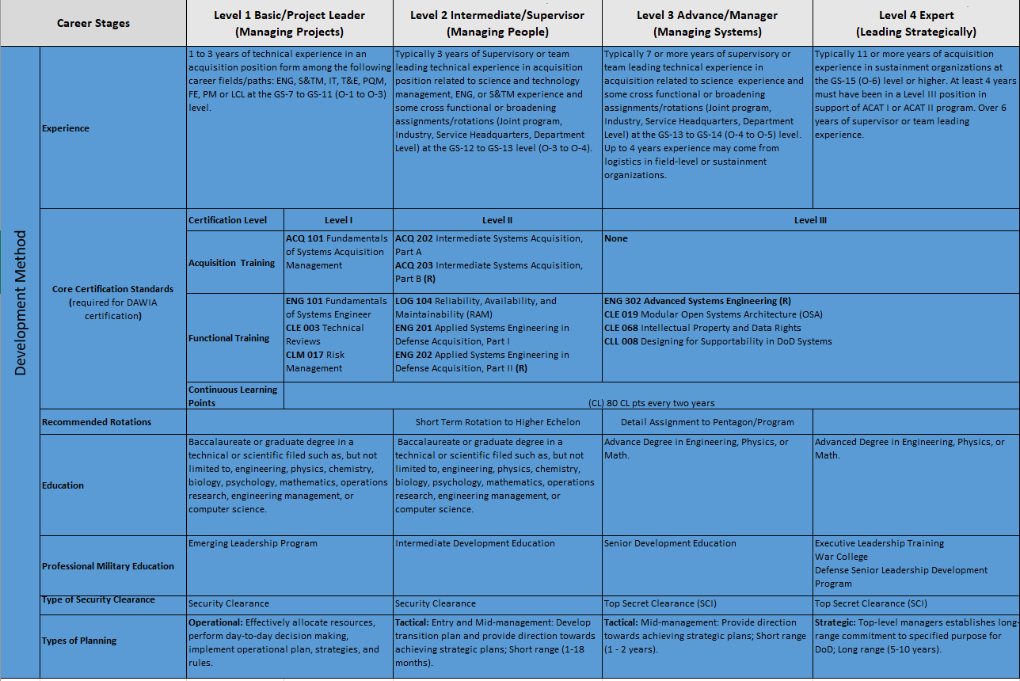
Development Method
Development Method

Slide 61

Access Database

Slide 62
Other Presentations
MBHSI – Lt.Col. Matt Taranto
DAU – Chris Barrett
Industry Perspective – Steve Merriman

Slide 63
Additional Comments
All sessions video recorded
Student papers and presentations will be migrated to APAN

Slide 64
HSI Competency Assessment (HCA)
Develop a method to assess the HSI knowledge and competency of personnel within DOD and other Federal agencies.
Tasks:
A plan of action and milestones.
A literature review that will identify the current state of the HSI body of knowledge.
An architecture for the HSI Competency Assessment that considers characteristics such as: practitioner experience level (e.g., novice, experienced, expert); job type (e.g., HSI practitioner, HSI domain practitioner, program manager, systems engineer, logistician, T&E, etc.); type of organization (DOD, DHS, NASA, defense contractor); activities (R&D, pre-MS A through MS C, Operations and Sustainment, Disposal).
Socialize the HSI Competency Assessment initiative through coordination and collaboration with HSI leaders throughout DOD and other Federal agencies (e.g., DHS, USCG, NASA, FAA, etc.).
Monthly progress reports.

Slide 65
Minimum HCA Requirements
An agreed upon body of knowledge
An acceptable competency model
HSI leaders who are cooperative, collegial, and open to compromise

Slide 66
HSI Creed/Tenets Example
Human Systems Integration (hereafter, HSI) can be defined as a philosophy, an approach to systems engineering, a set of processes as well as a goal.
A philosophy: By definition, HSI is a human-centered mindset; a way of thinking inculcated in those who design, build and manage the system throughout its life cycle. By definition, a system consists of hardware, software and humans (so-called ‘liveware’) who operate, maintain, and support said system within a given environment.
An approach to systems engineering: Those responsible for designing, testing, fielding and managing systems must ensure that human capabilities and limitations provide the foundation for systems engineering.
A set of processes: The tenets of HSI are realized through the various tools, techniques, approaches, methods, and standards that enhance the systems engineering process. .
A goal: The goal of HSI is to optimize total system performance through effective human integration with system hardware and software, while minimizing program costs and risks.

Slide 67
Questions?

